Slide 1

What is this ?
THIS IS A DOMINO

Slide 2
If you queued ten thousand dominoes on a very long table
and you want to let them all fall just by letting the first domino fall, Will it be possible?

Slide 3
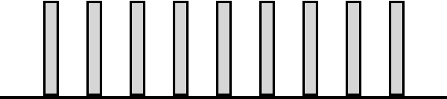
Let's line up a row of dominoes...

Slide 4

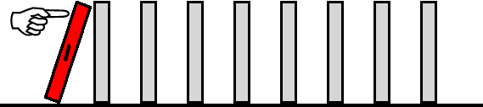
 | Can we knock down the first domino?

Slide 5

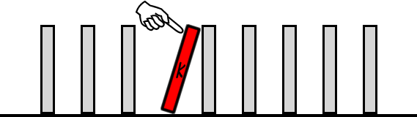
 | Can we knock down a random domino somewhere in the middle? Let's call it the kth domino.

Slide 6

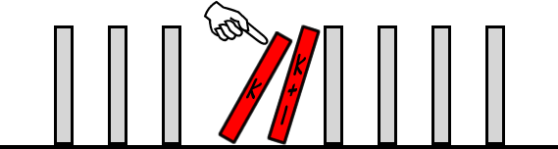
If we knock down that kth domino, will the next domino get knocked down too?

Slide 7


 | If we do all of the above, will all the dominoes fall?

Slide 8


Prove for all n ϵ N :
1.
2.

Slide 9
Of course, we cannot enumerate all the counting numbers, so we need to have a justification or proof of our conjecture above. The strategy used for proving such conjectures is called proof by mathematical induction.

Slide 10
In Mathematical Induction, if the condition is true for
n= 1, and
It is true for any natural number n = k, then
It is also true for n = k + 1, which implies it is true for all positive integers.

Slide 11



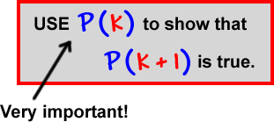


The four steps of Mathematical Induction:

Slide 12
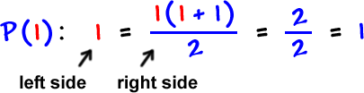


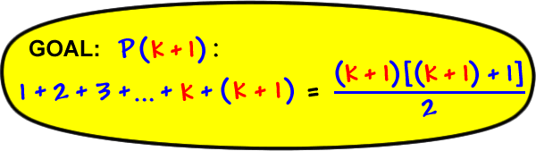
Prove by the Principle of Mathematical Induction for all n ϵ N
1.
*
*

Slide 13
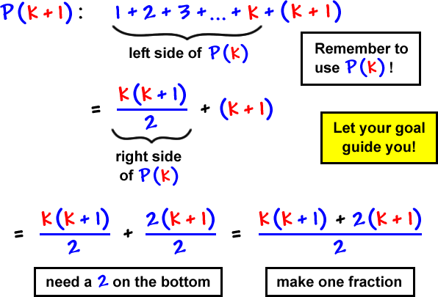
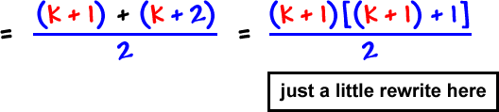
*
P(k+1) is true whenever P(k) is true. Hence by the Principle of M.I, P (n) is true for all n ϵ N

Slide 14
HOME - ASSIGNMENT
Prove by the Principle of Mathematical Induction, for all n ϵ N
1.
²
2.
P(n) : 1³ + 2³ + 3³ + ………+ n³ = n ( n + 1 )
2

